Slide 1



Guruji Astro Call Center Performance Data Analysis Report
Prepared By:
Name: Nitish Pandey Email: nitishpandey4393@gmail.com Phone: 8788840178
Date: 08-07-2024

Slide 2
Objective :-
The objective of this report is to analyze the provided call center performance dataset and provide insights and recommendations to improve call handling, user satisfaction, and earnings.
Tasks Performed:
Data Exploration:
Loading and cleaning the dataset.
Handling missing values.
Providing summary statistics.
Call Center Performance Metrics:
Calculating average TalkTime.
Identifying common call sources.
Analyzing earnings and spending.
Exploring the relationship between TalkTime and Charge.

Slide 3
3. Call Handling Analysis:
Evaluating call connection times.
Disconnection reasons.
HangUpTime trends.
4. Order and Refund Analysis:
Analyzing order status distribution.
Calculating refund amounts.
5. Insights and Recommendations:
Summarizing key findings.
Providing actionable recommendations.
6. Data Visualization:
Creating visualizations to support the analysis.
Line chart of call charges over time.
Scatter plot of TalkTime vs. UserSpend.
7. Interpretation:
Interpreting findings from visualizations.
Summarizing insights.

Slide 4
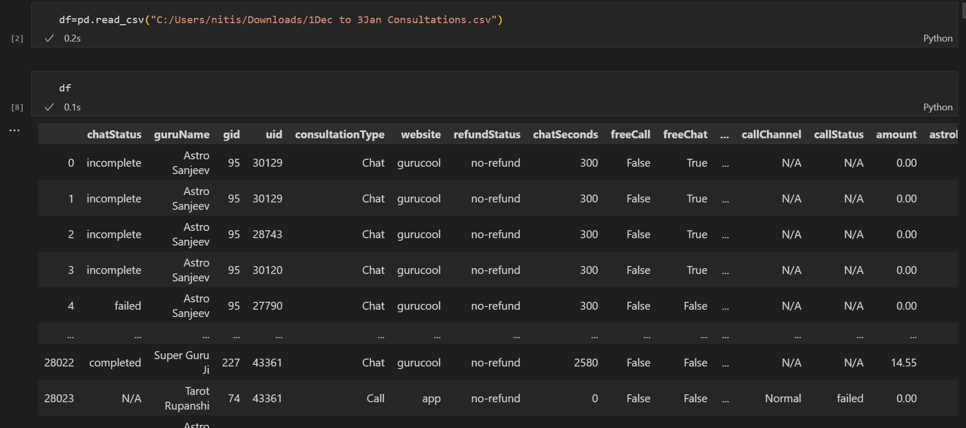
Task 1: Data Exploration :-
There are 45 column and 28028 rows.
1. Load the dataset into your preferred data analysis tool Python

Slide 5
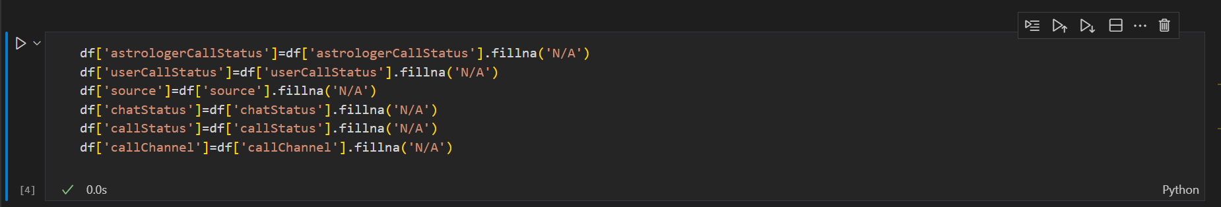
2. Check for missing values in the dataset and handle them appropriately
Deleted column which were not which were not required for analysis or had more than 99% empty rows.
Removed duplicates , trimmed columns ,checked data types of columns .
Column with null values replace it with N/A value we can’t delete that rows because those rows are important and help us in further analysis.

Slide 6
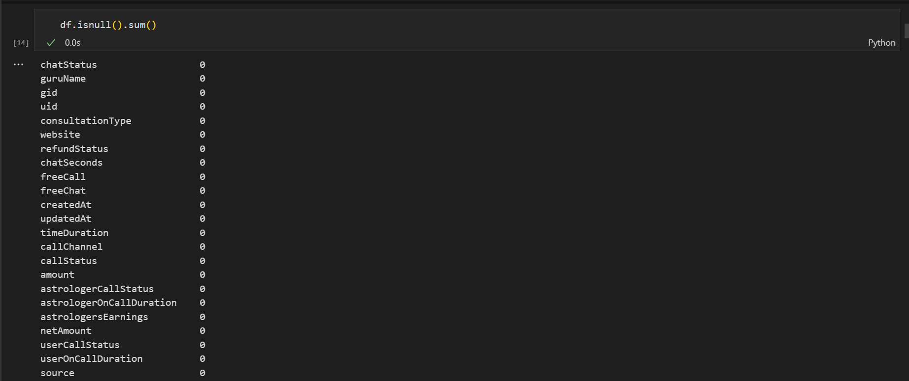
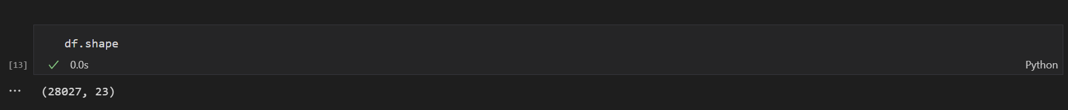

Slide 7
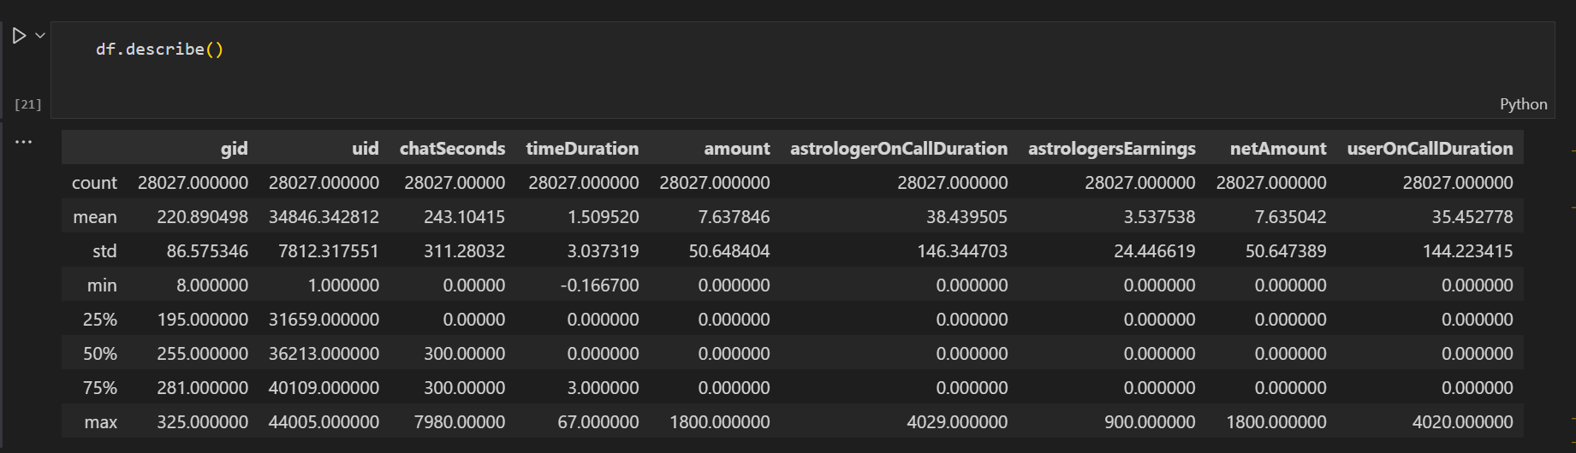
3. Provide summary statistics for key numeric columns (e.g., Charge, TalkTime).

Slide 8
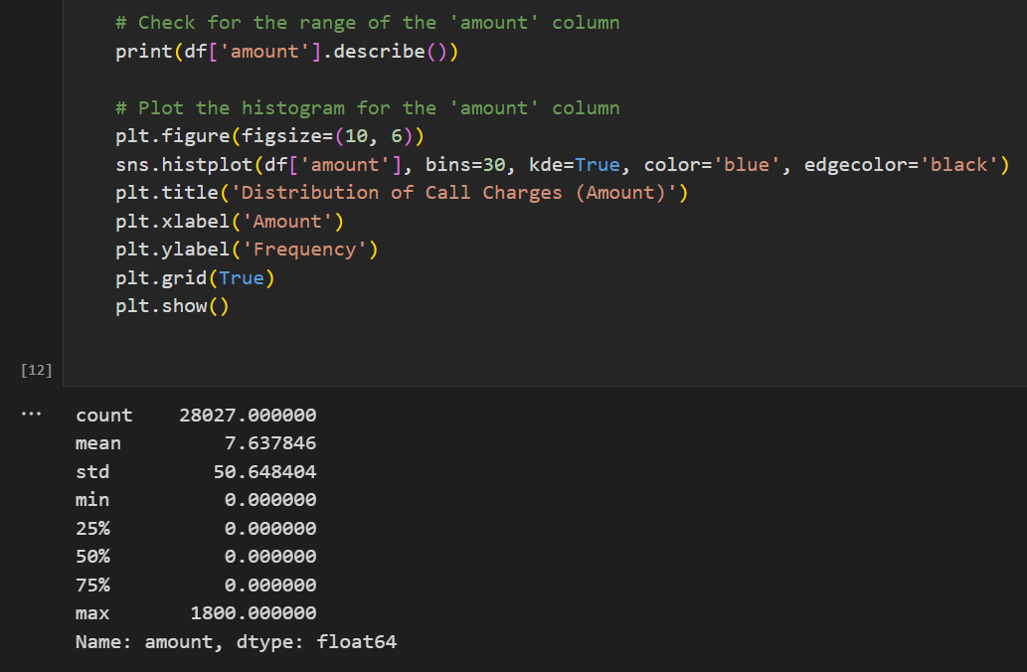
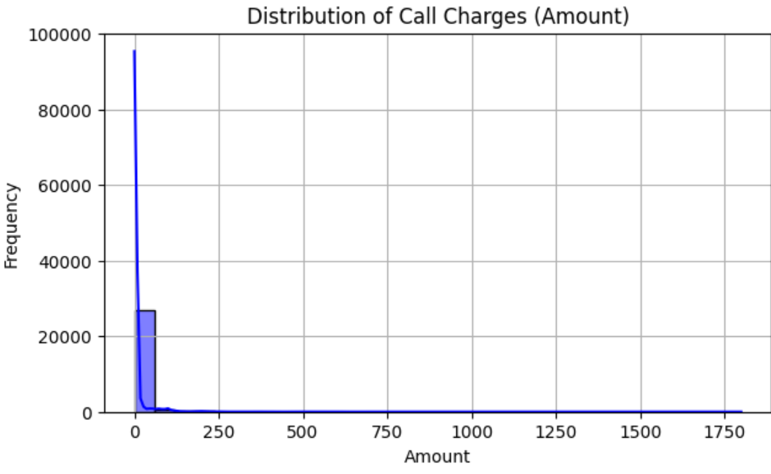
4. Visualize the distribution of call charges using a histogram.

Slide 9
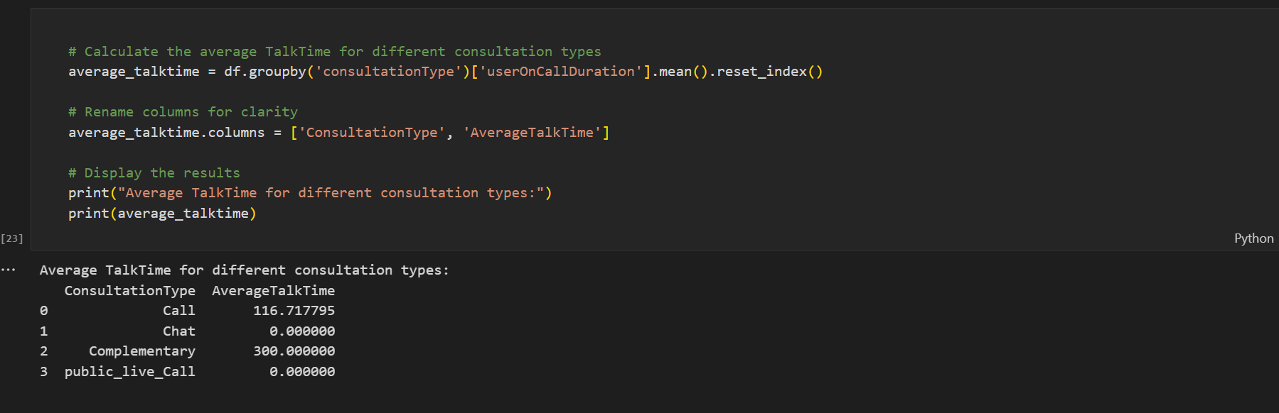
Task 2: Call Center Performance Metrics
5. Calculate the average TalkTime for different call activities (Activity column).

Slide 10
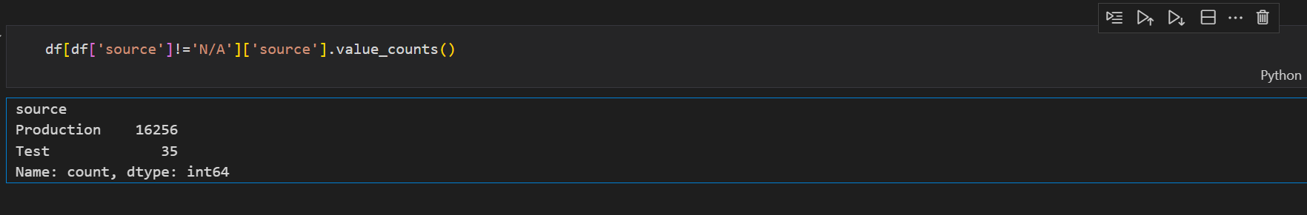
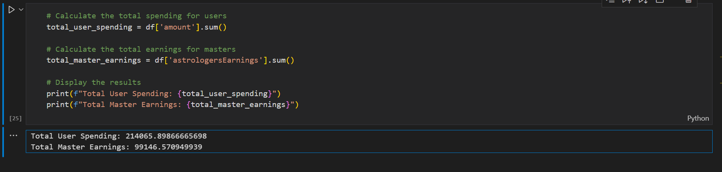
6. Determine the most common source of calls (Source column)
7. Calculate the total earnings and spending for both users and masters

Slide 11
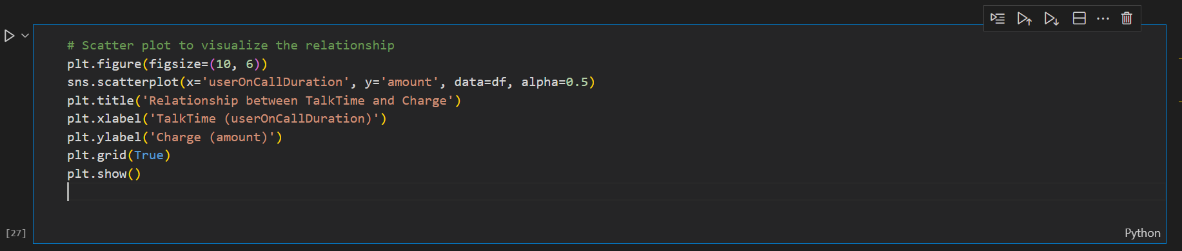
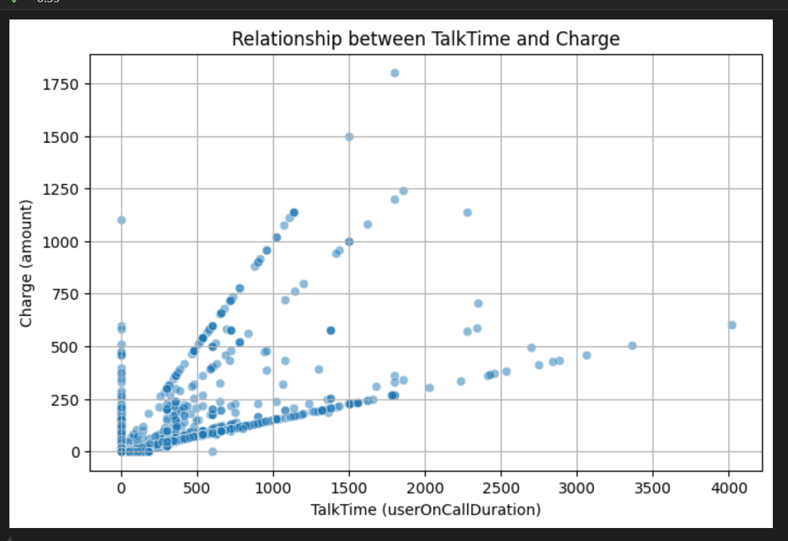
8. Analyze the relationship between TalkTime and Charge

Slide 12
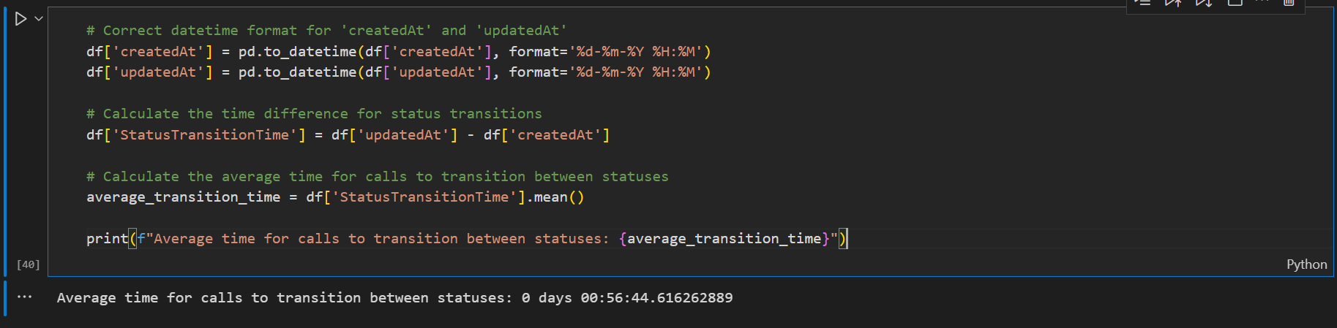
Task 3: Call Handling Analysis
9. Calculate the average time it takes for calls to be connected (ConnectTime - DialTime) (note:- we do not have (ConnectTime - DialTime) column)

Slide 13
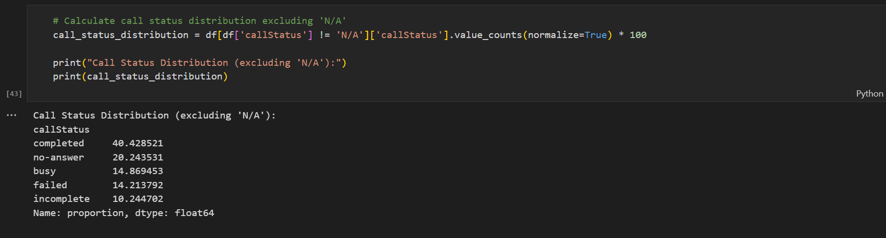
10. Identify the most common reason for call disconnection (UnconnectTime - ConnectTime).

Slide 14
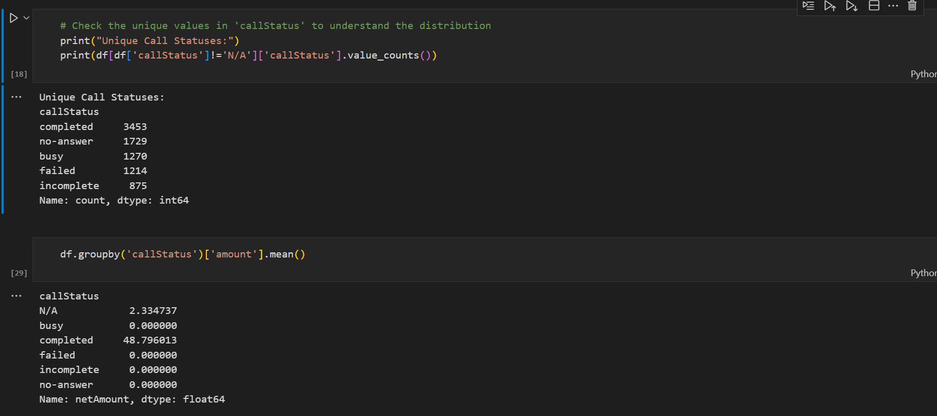
11. Analyze the HangUpTime patterns and identify any trends

Slide 15
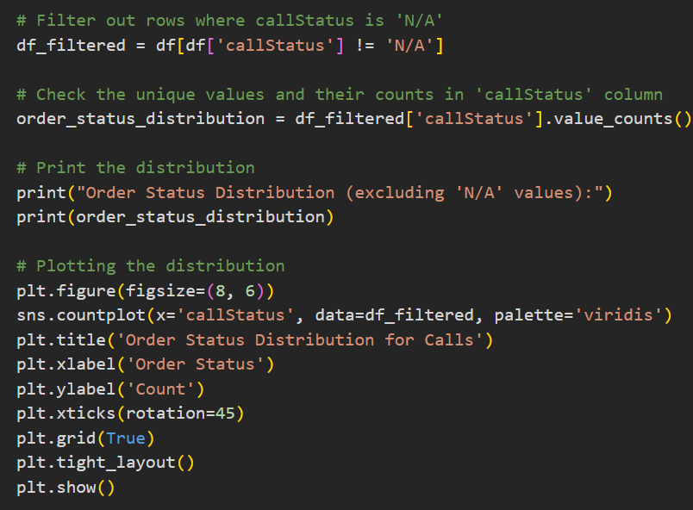
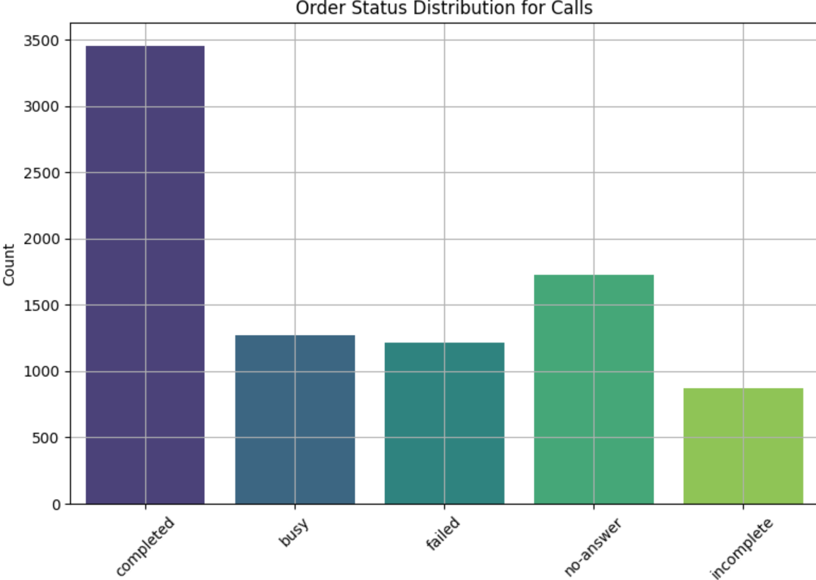
Task 4: Order and Refund Analysis
12. Determine the order status distribution for calls.

Slide 16
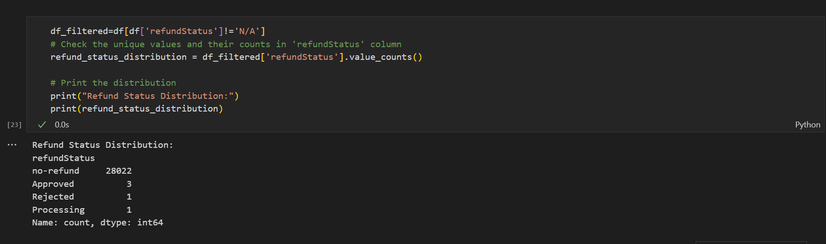
13. Calculate the total refund amount and identify the refund status distribution.

Slide 17
Task 5: Insights and Recommendations
Optimize Service Availability During Peak Hours:
Insight: From 9:00 a.m. to 10:00 p.m. are the most busy hours.
Recommendation: Ensure maximum availability of astrologers during these peak hours to handle the high volume of interactions efficiently.Consider scheduling more staff or offering incentives for astrologers to be available during these times.
Address and Reduce Bad Status Counts:
Insight: Astro Shakti and Astro Krisha have higher counts of bad status interactions (Incomplete, Failed, Canceled, No- answer).
Recommendation: Investigate the reasons behind these statuses for Astro Shakti and Astro Krisha. Provide additional training or resources to help them improve their interaction quality. Implement feedback mechanisms to identify and address issues promptly.
Focus on High-Interaction Astrologers:
Insight: Astro Chandan, Taroot Kashmir, and Taroot Srishti have higher interaction times, with Astro Chandan having the highest at 2 hours and 21 minutes.
Recommendation: Highlight these astrologers in marketing campaigns to attract more users. Recognize and reward their efforts to motivate other astrologers to increase their interaction times.

Slide 18
Improve Call and Chat Completion Rates:
Insight: Only 40.4% of call statuses and 28.4% of chat statuses are completed.
Recommendation: Investigate the reasons behind low completion rates. Implement measures to enhance the user experience, such as improving platform reliability, offering better training to astrologers, and streamlining the interaction process.
Leverage High-Earning Astrologers:
Insight: Dr. Balkrishnan has the highest earnings with ₨15910.20 from 309 calls and 378 chats.
Recommendation: Use Dr. Balkrishnan’s successful approach as a model for other astrologers. Share best practices and strategies that lead to higher earnings. Promote high-earning astrologers to attract more clients.
Enhance Website and App Integration:
Insight: Consultations via the website are significantly higher (20225) compared to the app (7800).
Recommendation: Improve the app experience to increase consultations through it. Ensure that both platforms offer seamless and user-friendly interactions. Consider integrating features that are popular on the website into the app.
Diversify Consultation Types:
Insight: Distribution of consultation types shows 19514 chats and 8508 calls.
Recommendation: Promote the benefits of both chat and call consultations to users. Offer packages or discounts for trying different types of consultations to balance the usage between chat and call.

Slide 19
Target High-Spending Users:
Insight: User ID 17696 has total spending of 26228, and user ID 33017 has total spending of 18723.
Recommendation: Identify and engage with high-spending users through personalized offers and premium services. Build loyalty programs to retain these valuable customers.
Monitor and Improve Source Performance:
Insight: Source production has 16256 interactions, while the test source has only 35.
Recommendation: Focus on optimizing the production source as it has the highest interactions. Ensure that any changes or updates are thoroughly tested to avoid disruptions.
Analyze Time-Based Spending Patterns:
Insight: Spending tends to increase at the start of the month.
Recommendation: Plan promotions and special offers at the start of the month to capitalize on the increased spending behavior.Use this pattern to predict and manage resource allocation.
Utilize Earnings Data for Growth:
Insight: Total user spending is 214065, and total astrologer earnings are 99146.57.
Recommendation: Analyze the earnings data to identify trends and opportunities for growth. Use this information to adjust pricing strategies and improve overall revenue management.

Slide 20
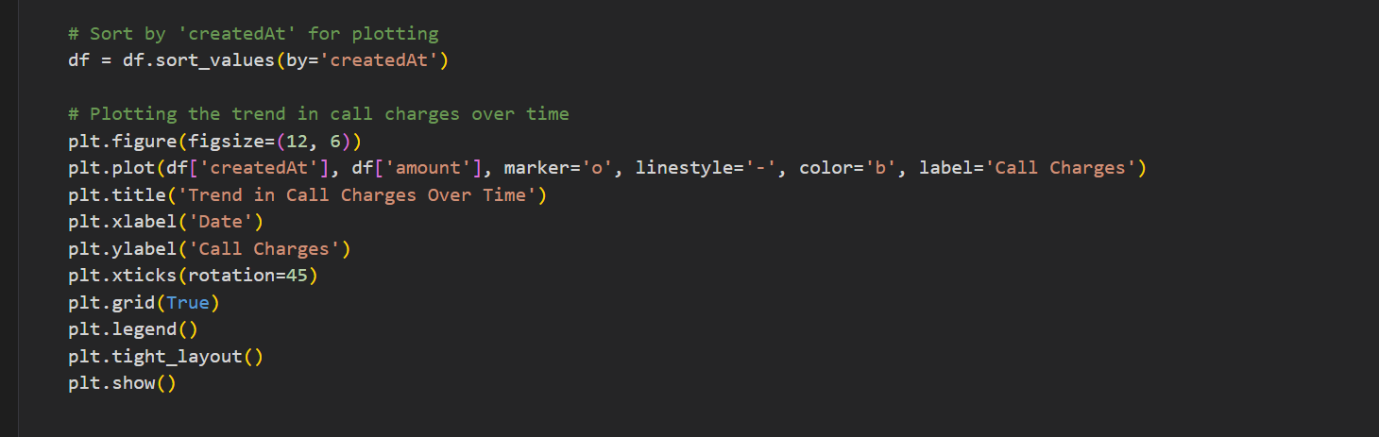
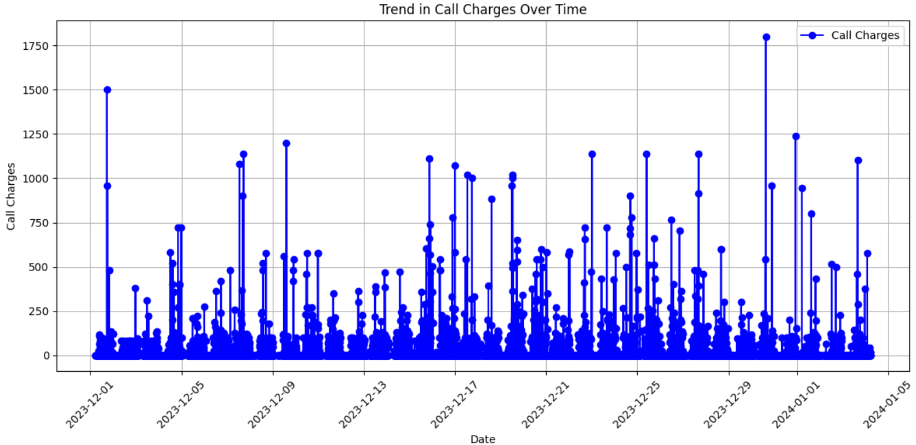
Task 6: Data Visualization
Please create a line chart showing the trend in call charges over time.

Slide 21
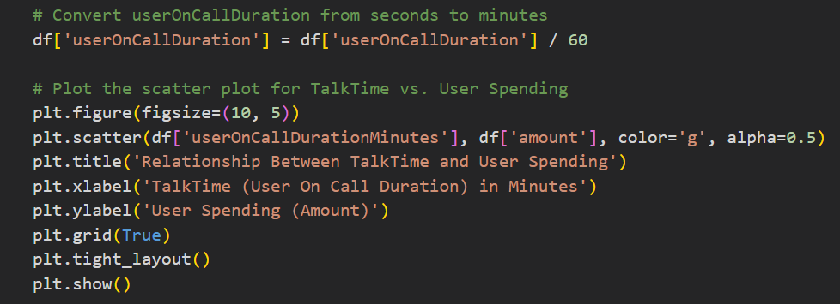
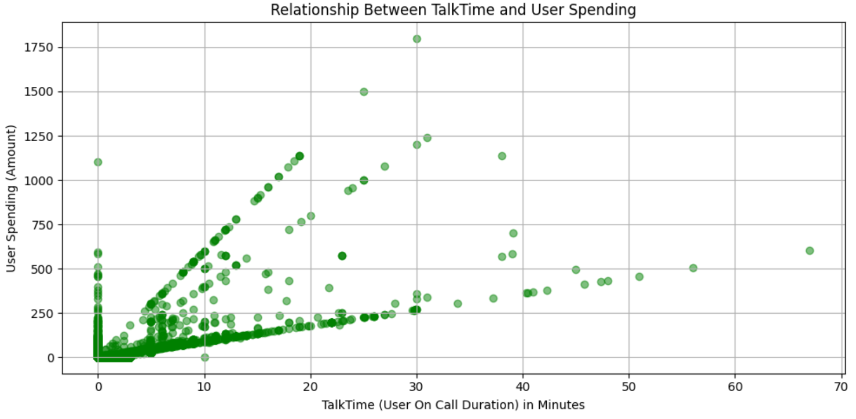
Create a scatter plot to analyze the relationship between TalkTime and UserSpend.

Slide 22
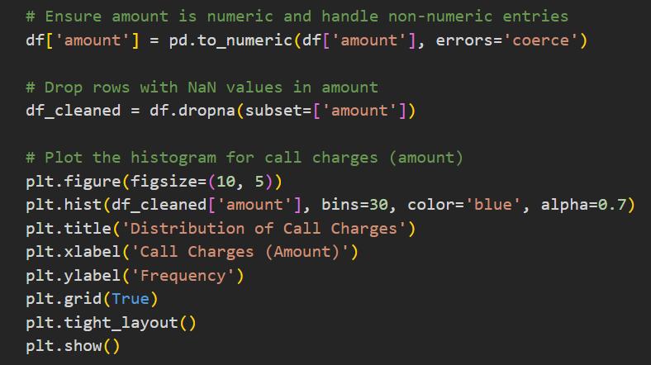
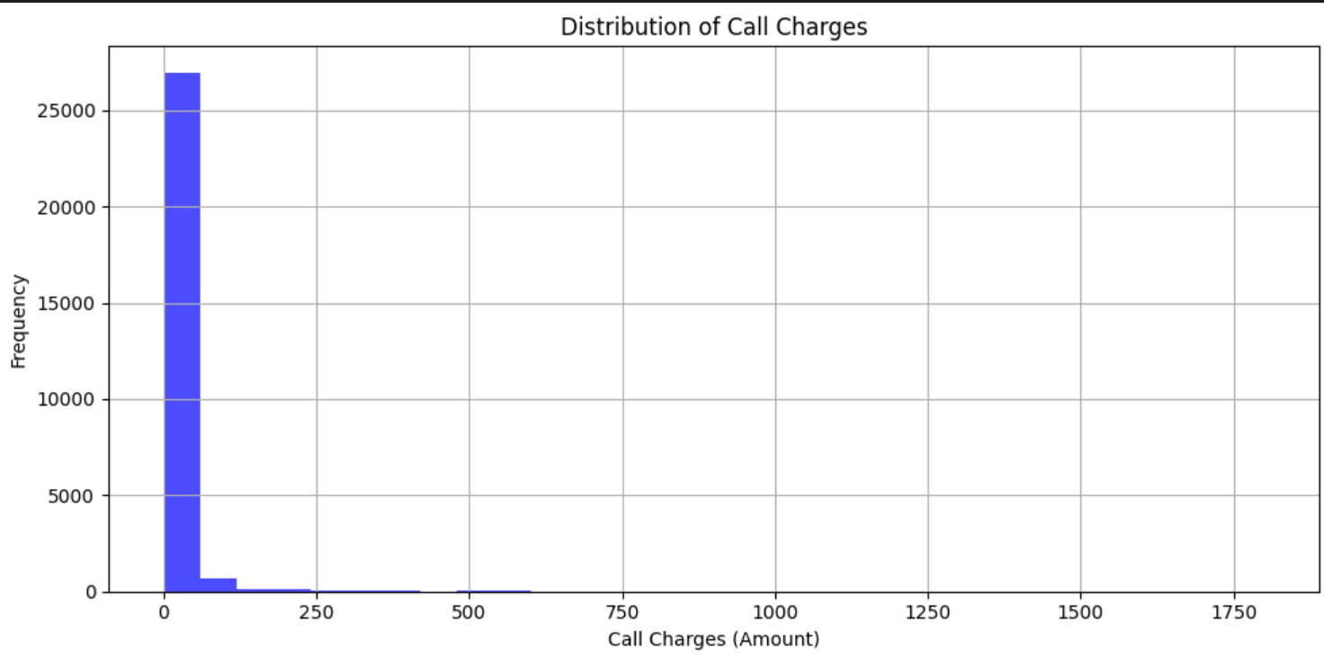
Task 7: Interpretation
What insights can you draw from the histogram of call charges?

Slide 23
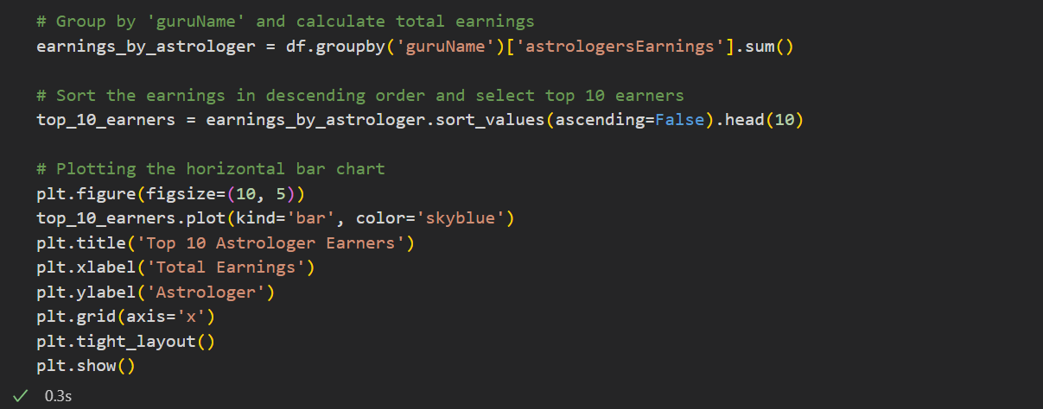
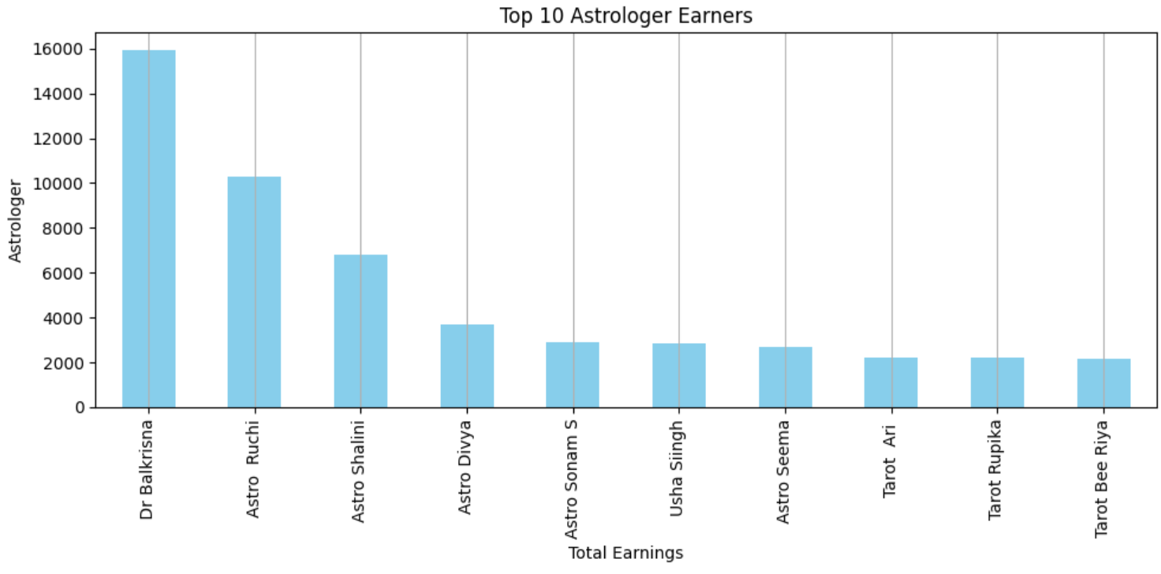

Slide 24
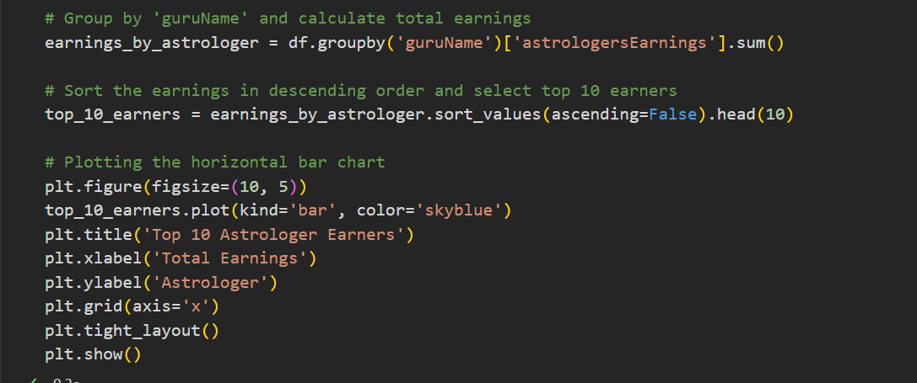
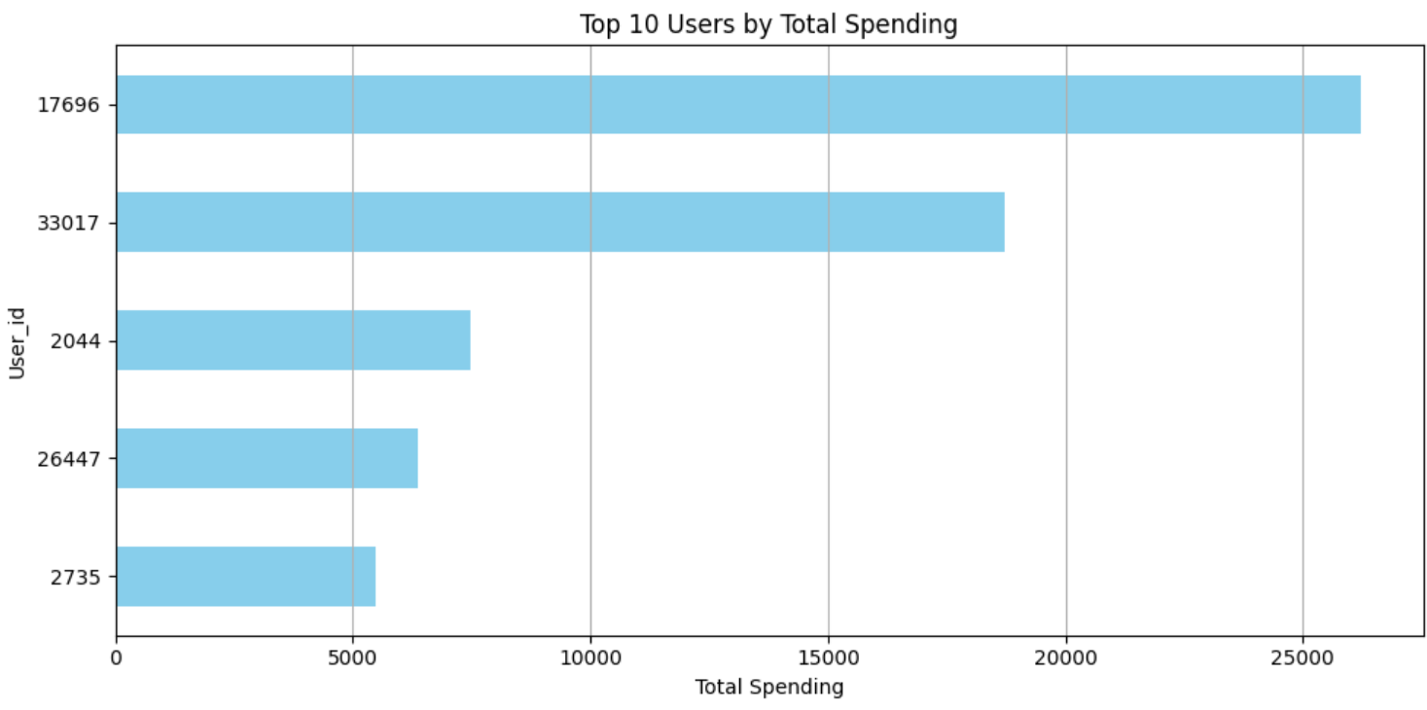

Slide 25
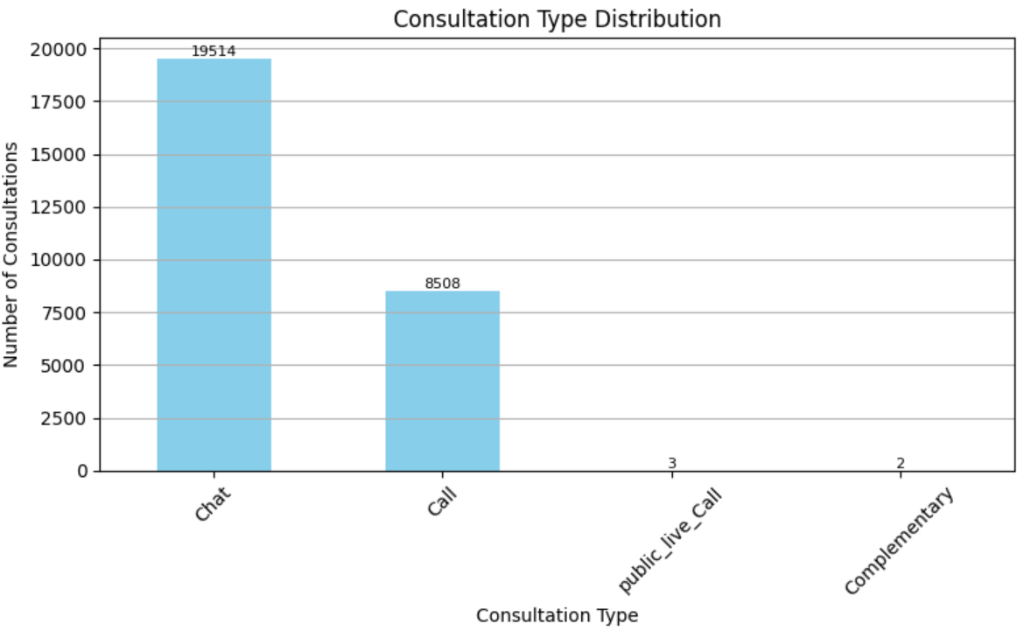
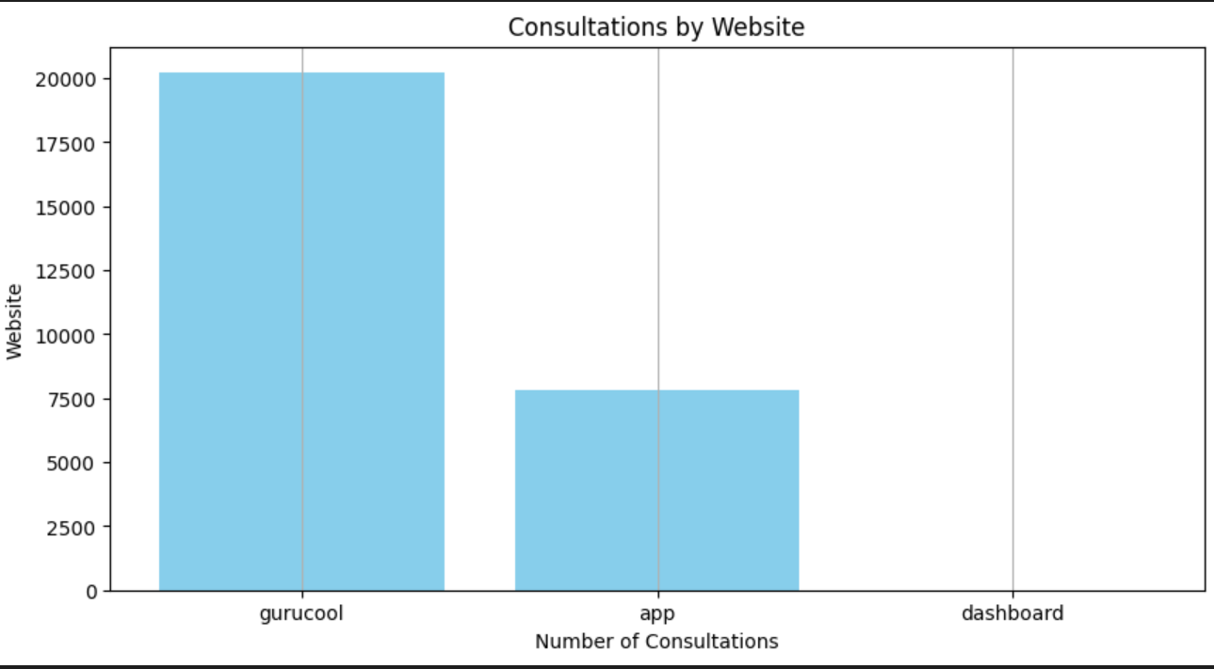
- PEOPLE PREFER TO CHAT MORE OVER CALL
MOSTLY PEOPLE PREFER GURUCOOL WEBSITE FOLLOWED BY APP

Slide 26
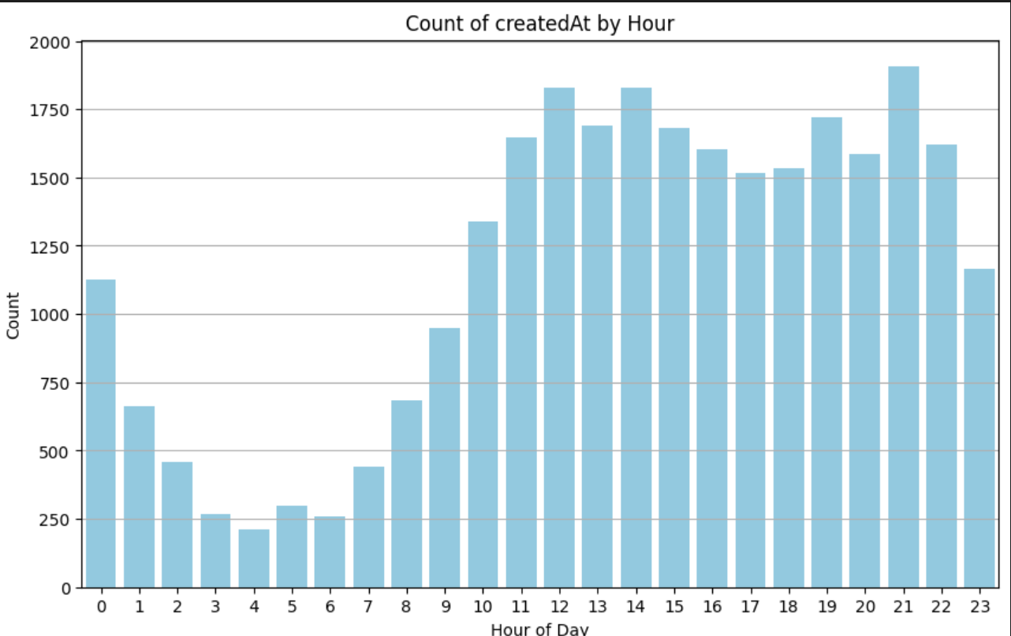
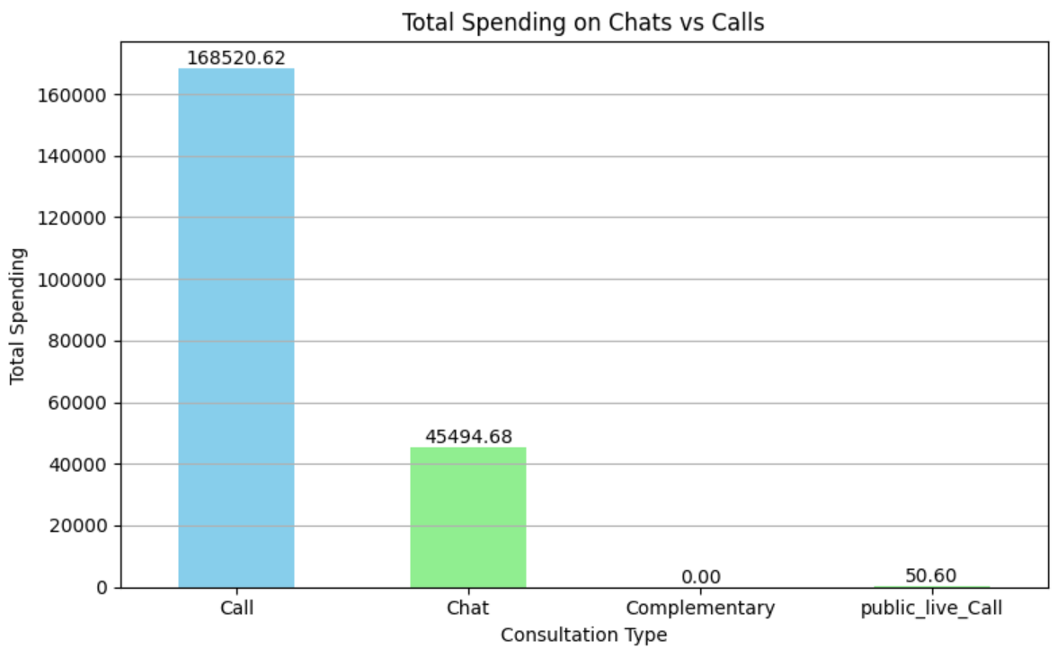
- 9 AM TO 10 PM HAS HIGHEST BUSY HOURS
-MOSTLY PEOPLE ARE SPENDING ON CALLS FOLLOWED BY CHAT

Slide 27
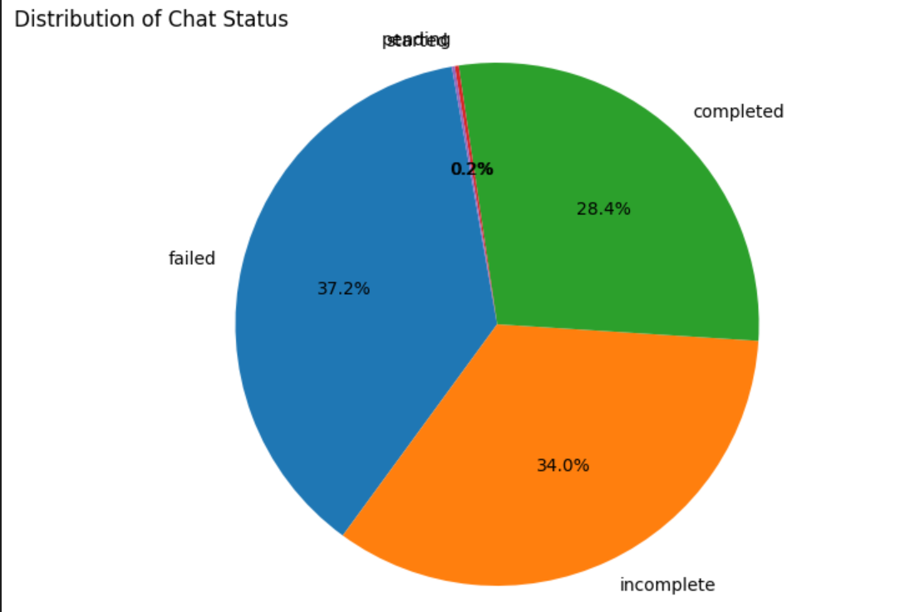
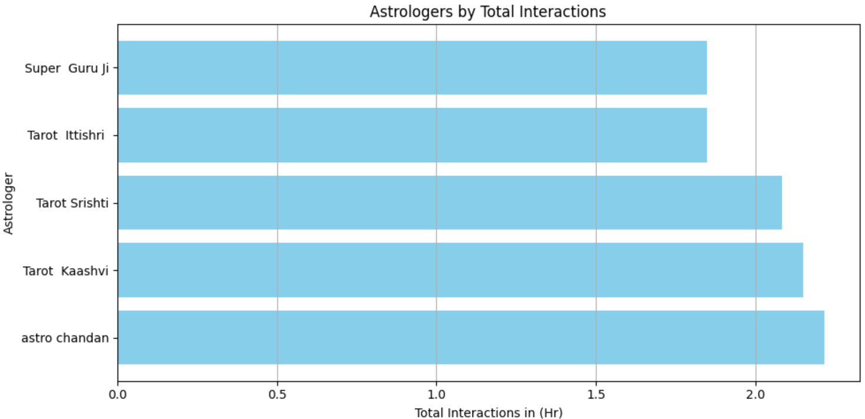
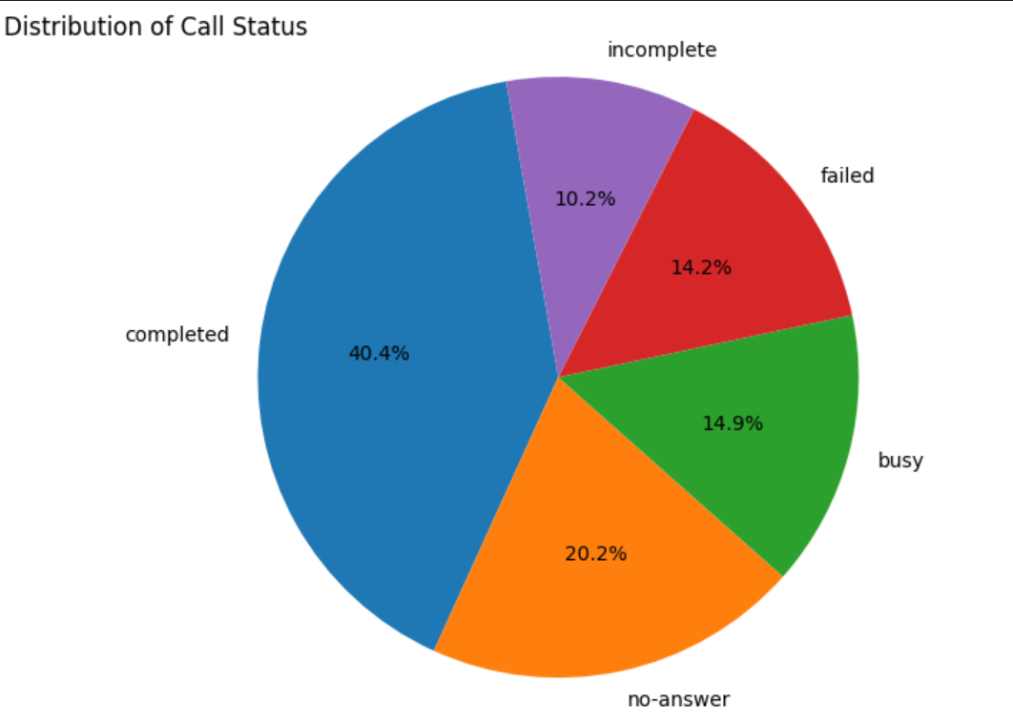
ASTRO CHANDAN HAS HIGHEST INTERACTION WITH 2HR 21 MINUTES
ONLY 28.4% CHATS ARE COMPLETED
ONLY 40.4% OF CALLS ARE COMPLETED

Slide 28
THANK YOU

